Slide 1
database cloning
with devops flavour

Slide 2

about:me
Kirill Kravtsov - @nvarscar
SQL Server DBA at Wawanesa Insurance
10 years of SQL Server experience
DB Engine, SSRS, SSIS, SSAS
Automation – VBS, T-SQL, Powershell

Slide 3
agenda
Database cloning
SSMS
T-SQL
Powershell
…
Data masking and obfuscating
Clone distribution

Slide 4
clone wars tiers
Tier 1: exact clone
Backup/restore
Cold copy
Disk snapshots
Tier 2: full clone
Full export/import
Object-level cloning
Tier 3: partial clone
Replication
Schema only
Per-table data transfer

Slide 5

backup/restore
\\network\share
Source
Copy-only full backup
Restore backup
Destination
\\backup\share
Scheduled backups
Restore backup

Slide 6
cold copies
Source database is offline
File-to-file copy
Attached as a new database
Log Shipping
Cold copy

Slide 7
disk snapshots
Better served cold
Requires specific hardware and/or software
Might impact production, unless a staging server is used
Production
Staging
Snapshot
Windows VHD

Slide 8
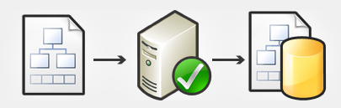
import/export
Data-tier Application packages: DACPAC/BACPAC
Can include both schema and data
Uses BCP to extract and publish data
Compressed
Variety of deployment parameters
Learning curve
Reading directly from the database

Slide 9


object cloning
SMO-based (SQL Management Object)
Limited configuration options in SSMS
Not always works as expected
Reading directly from the database

Slide 10
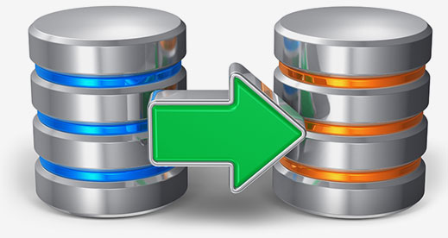
replication
Near real-time clone
Requires server configuration
Scalability is an issue
Locks down objects in the source database
Haven’t seen updates ever since SQL 2008

Slide 11
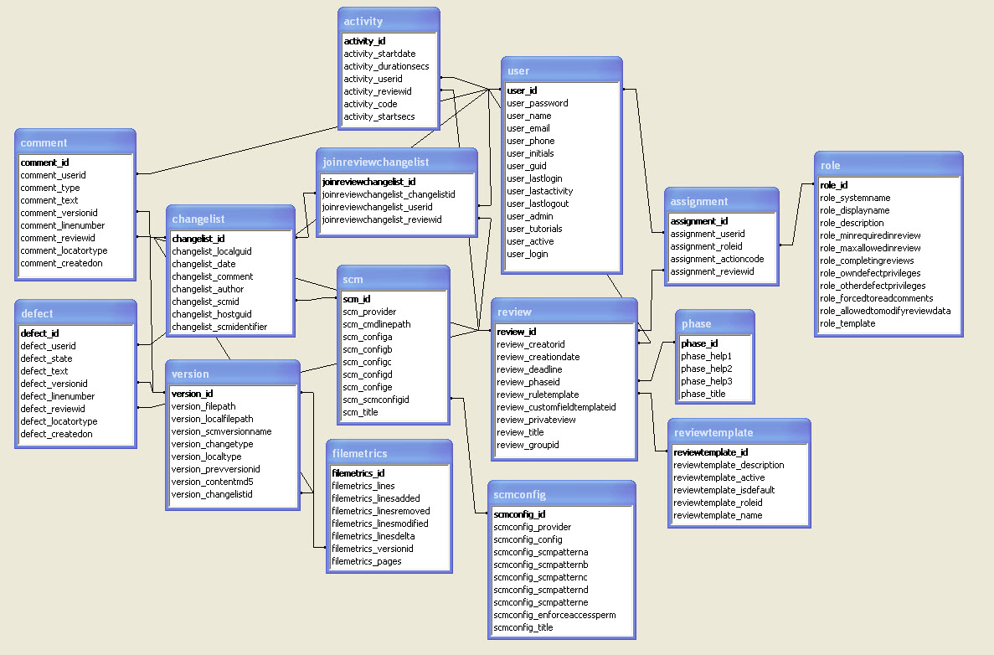
schema only
DACPAC/BACPAC
SMO script engine
DBCC CLONEDATABASE
Custom scripts
… data?

Slide 12
per-table data transfer
WYNIWYC (What You Need Is What You Clone)
Table definitions might suffer
Referential integrity is hard to maintain

Slide 13

data masking
Always a challenge
Maintaining integrity can be a challenge
Slow against big datasets

Slide 14

distribution
Full sized-copy on a disk drive
Snapshots
Docker image (optionally, via Kubernetes)

